Slide 1
Basic Computing Curriculum
Session 2: Introduction to the Operating System
Notes:
In this presentation, we will learn the basics of Operating System. We will discuss the definition of Operating System and the different types of Operating System.

Slide 2

Presentation Overview
Introduction to Operating System
  This section will provide an overview of Operating System and its importance in the functioning of computers.
Basic Functions of Operating System
  This section will explain the basic functions of an Operating System, including managing hardware resources, software applications, and user accounts.
File Navigation and Management
  This section will cover file navigation and management techniques, including creating, copying, moving, and deleting files and folders.
Hands-on Exercise
  This section will provide a practical activity to give hands-on experience in navigating the Operating System and organizing files into folders.
Notes:
We will start with an Introduction to Operating System, followed by Basic Functions of Operating System and File Navigation and Management. We will end with a practical activity to give hands-on experience in navigating the Operating System and organizing files into folders.

Slide 3
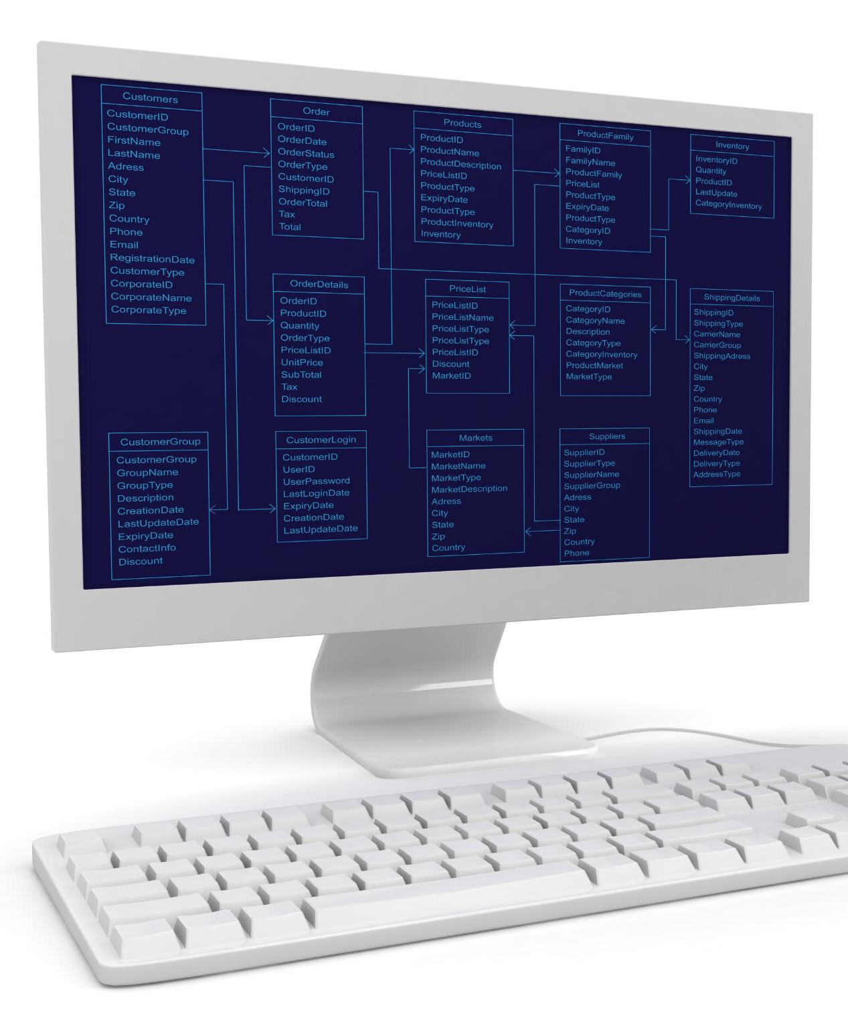
Definition of Operating System
Interface between User and Hardware
  The Operating System acts as an interface between the user and the hardware, allowing the user to interact with the computer and perform tasks.
Resource Management
  The Operating System manages the resources of the computer, such as the processor, memory, and peripheral devices, ensuring that they are used efficiently and effectively.
Types of Operating System
  There are different types of Operating System, such as Windows, Linux, and MacOS, each with its own features and capabilities.
Notes:
Operating System is a program that acts as an interface between the user and the hardware. It manages the resources of the computer, such as the processor, memory, and peripheral devices. There are different types of Operating System, such as Windows, Linux, and MacOS.

Slide 4
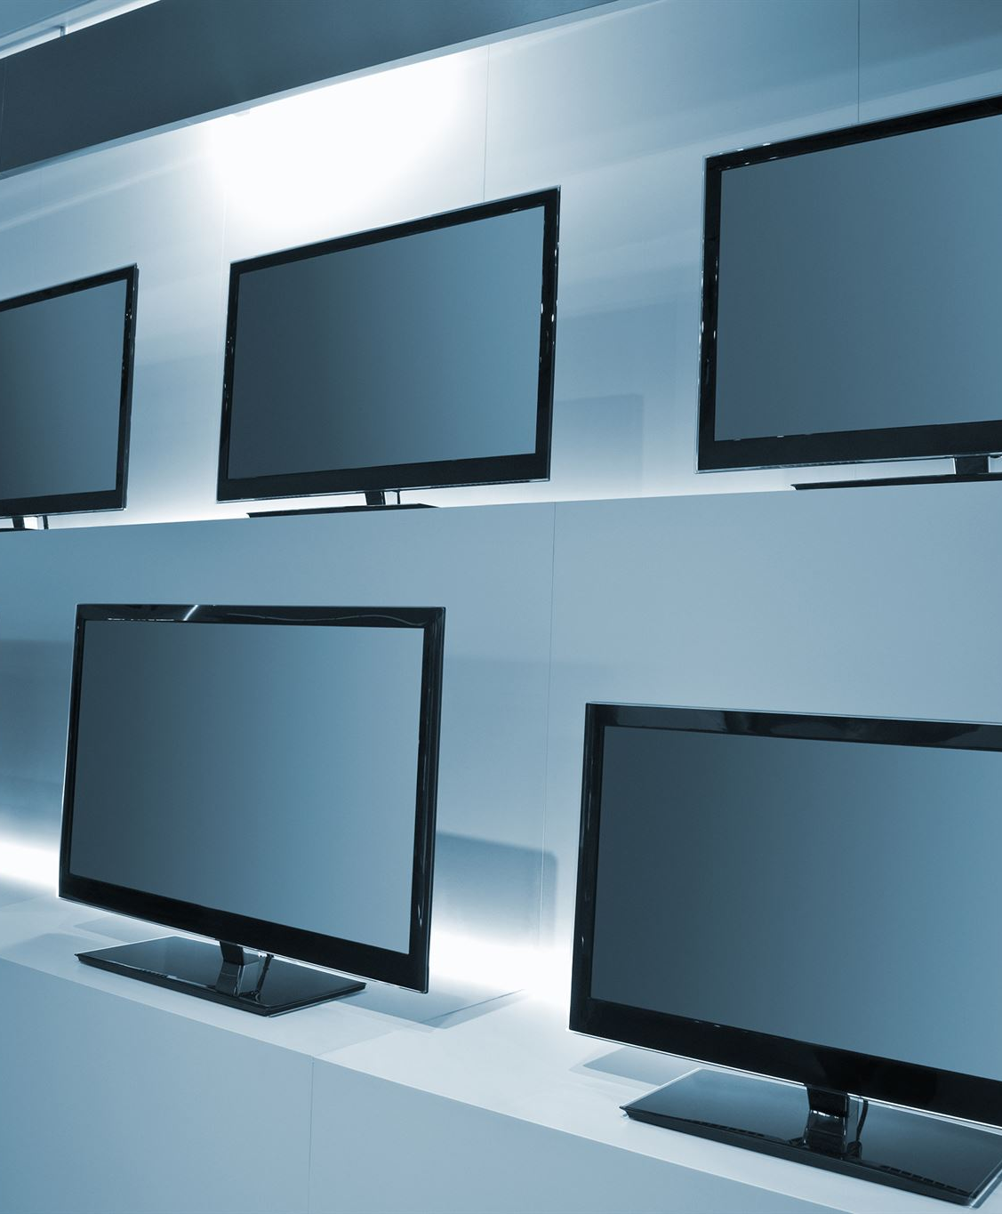
Types of Operating System
Windows
  Windows is the most widely used Operating System in the world. It is known for its user-friendly interface and ease of use. It is available in different versions, such as Windows 7, Windows 8, and Windows 10.
Linux
  Linux is an open-source Operating System that is popular among developers and programmers. It is known for its security and stability.
MacOS
  MacOS is the Operating System used in Apple computers. It is known for its user-friendly interface and seamless integration with other Apple products.
Notes:
Windows is the most widely used Operating System in the world. It is known for its user-friendly interface and ease of use. It is available in different versions, such as Windows 7, Windows 8, and Windows 10. Linux is an open-source Operating System that is popular among developers and programmers. MacOS is the Operating System used in Apple computers.

Slide 5

Basic Functions of Operating System
Desktop Management
  Operating System manages the desktop and allows the user to customize it by changing the wallpaper, adding or removing icons, and creating folders to organize files.
Window Management
  Operating System manages the windows and allows the user to open, close, and minimize them. This can be done using the mouse or keyboard shortcuts.
Menu Management
  Operating System manages the menus and allows the user to access different applications and settings. The menus can be accessed using the mouse or keyboard shortcuts.
Notes:
The basic functions of Operating System include managing the desktop, windows, icons, and menus. It also allows the user to open, close, and minimize windows. These functions can be performed using the mouse or keyboard shortcuts.

Slide 6
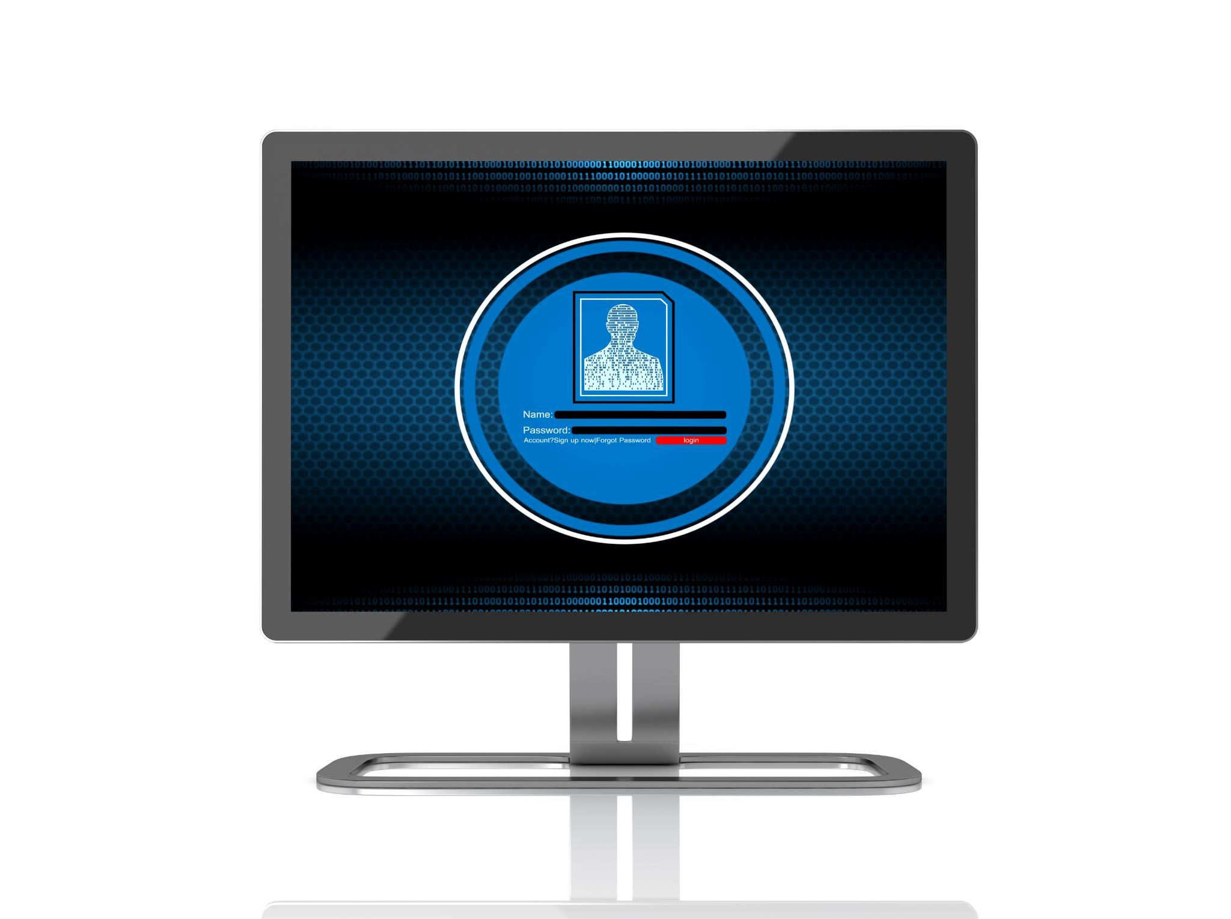
Desktop, Windows, Icons and Menus
Desktop
  The desktop is the initial screen that appears when a user logs into the computer. It contains icons and shortcuts to different programs and files that enable easy access.
Windows
  Windows are individual screens that pop up when a program is opened. Multiple windows can be opened and arranged to increase productivity.
Icons
  Icons are small images that represent different programs or files. They help users to quickly identify and access the required file or software.
Menus
  Menus are the lists of commands or options that appear when a user clicks on the icon or right-clicks on the desktop. They enable users to perform various operations and customize their computing experience.
Notes:
The desktop is the first screen that the user sees after logging into the computer. It contains icons and shortcuts to different programs and files. Windows are the individual screens that open up when a program is opened. Icons are the small images that represent different programs or files. Menus are the lists of commands or options that appear when a user clicks on the icon or right-clicks on the desktop.

Slide 7
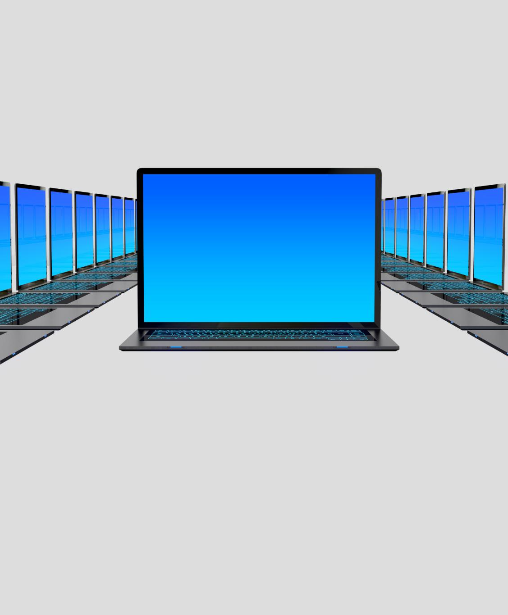
Opening, Closing, and Minimizing Windows
Opening Windows
  Windows can be opened by double-clicking on the icon or by clicking on the taskbar.
Closing Windows
  Windows can be closed by clicking on the X button or by using the Alt + F4 keyboard shortcut.
Minimizing Windows
  Windows can be minimized by clicking on the minimize button or by using the Windows + Down Arrow keyboard shortcut.
Notes:
Windows can be opened by double-clicking on the icon or by clicking on the taskbar. They can be closed by clicking on the X button or by using the Alt + F4 keyboard shortcut. They can be minimized by clicking on the minimize button or by using the Windows + Down Arrow keyboard shortcut.

Slide 8
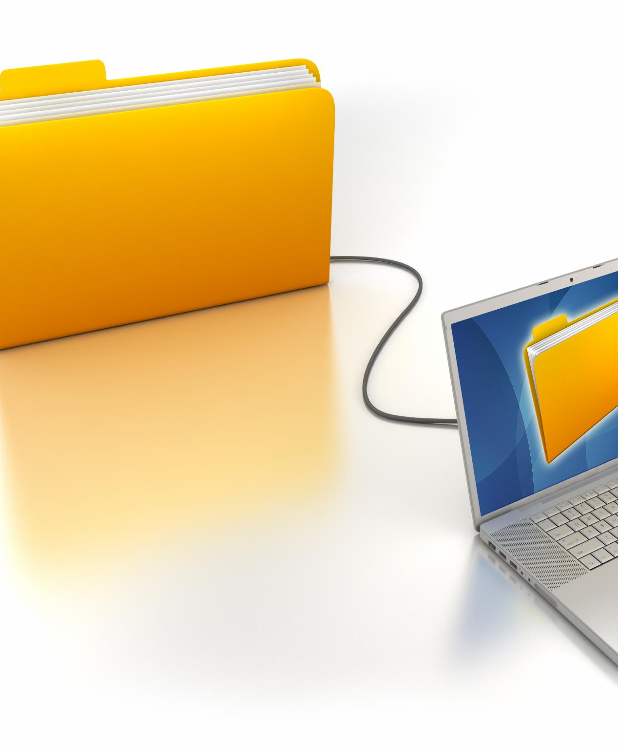
File Navigation and Management
Navigation
  File Explorer allows the user to easily navigate through files and folders on the computer, helping to quickly locate files and organize them efficiently.
File and Folder Management
  File Explorer makes it easy to create, delete, and move files and folders, allowing users to efficiently manage their files and keep their computer organized.
Search
  File Explorer provides a search bar that allows the user to quickly find files on their computer. This feature helps users save time by avoiding the need to manually locate files and folders.
Notes:
File Explorer is the file management system in Windows. It allows the user to navigate through the files and folders on the computer. The user can create, delete, and move files and folders. The user can also search for files using the search bar.

Slide 9

File Explorer
Navigating Files and Folders
  File Explorer provides a hierarchical structure for navigating files and folders in Windows, allowing users to easily locate and access their desired files or folders.
Creating New Folders
  Users can create new folders in File Explorer by simply right-clicking and selecting New Folder, allowing them to easily organize and manage their files.
Moving Files
  File Explorer allows users to easily move files between folders by simply dragging and dropping them into the desired folder, making it a convenient tool for managing files.
Notes:
File Explorer is the primary tool for navigating and managing files in Windows. It displays the files and folders in a hierarchical structure. The user can navigate through the folders by clicking on them. The user can create new folders by right-clicking and selecting New Folder. The user can move files by dragging and dropping them into the desired folder.

Slide 10

Managing and Organizing Files
  Users can manage and organize files by copying, deleting, creating folders and moving files into them, and searching for files using the search bar. Organized files make it easy to locate them quickly and efficiently.
Notes:
The user can manage files by deleting them or copying them to another location. The user can organize files by creating folders and moving files into them. This helps to keep the files organized and easy to find. The user can also search for files using the search bar.

Slide 11

Practical Activity
  This practical activity will give you hands-on experience in using the Operating System. You will learn how to navigate the operating system, open basic programs, and organize files into folders.
Notes:
In this practical activity, we will navigate the Operating System, open basic programs, and organize files into folders. This will give us hands-on experience in using the Operating System.

Slide 12

Conclusion
  Operating System is an essential part of a computer that manages the resources of the computer and acts as an interface between the user and the hardware. Understanding the basic functioning of the Operating System is important for every computer user.
Notes:
In conclusion, Operating System is an essential part of a computer. It manages the resources of the computer and acts as an interface between the user and the hardware. Understanding the basic functioning of the Operating System is important for every computer user.

